Slide 1
Income distribution, labour market returns and school quality
REDI3x3 Income Distribution Workshop
4 November 2014
Rulof Burger

Slide 2
Motivation
High inequality and low income mobility in SA
Is failure of our school system at the heart of our failure to increase social mobility and to reduce income inequality?
  Labour market inequality is central to overall inequality and to poverty
  Weak education is central to wage inequality
Important research questions:
  What is the role of education in employment and earnings?
  What is the quality of education offered to poor children?

Slide 3
Two strong South African regularities
Labour market (Mincerian returns to education) – a strong and convex positive relationship between schooling and wages
School system (social gradient) – a strong and convex positive relationship between SES and school performance

Slide 4
SA’s dualistic school system and labour market
High quality schools
±10-15 % of schools, mainly former (though no longer) white
Produce strong cognitive skills
Teachers qualified, schools functional, good assessment, parent involvement
High productivity jobs & incomes
±10-15% of labour force – mainly professional, managerial & skilled jobs
Requires degree, good quality matric, or good vocational skills
Historically mainly whites
Big demand for good schools, despite fees
A few schools cross the divide
Some talented, motivated or lucky students manage the transition
Vocational training
Affirmative action
Low quality schools
Very weak cognitive skills
Teachers less qualified, de-motivated, schools dysfunctional, assessment weak, little parental involvement,
Mainly former black (DET) schools
Low productivity jobs & incomes
Often manual or low skill jobs
Limited or low quality education
Minimum wage can exceed their productivity

Slide 5
Current research projects
Five research projects at University of Stellenbosch / ReSEP on South African income distribution, labour market and school quality:
  Prospects for income distribution and poverty
  Gains from attending an advantaged school
  The effect of job tenure on earnings
  The South African schooling earnings profile
  Income mobility and measurement error

Slide 6
  South African schooling-earnings profile
Research questions:
  What are the effects of different schooling years on earnings?
  How important are differences in these returns across individuals (e.g. due to differences in the quality of schooling)?
Motivation:
  Consensus that education increases productivity of workers and hence wages and probability of employment
  However, many African countries (incl. SA) achieved improved access to education and increased educational attainment with disappointing results ito labour market outcomes
  These countries have often also seen increasingly convex schooling-earnings profiles

Slide 7
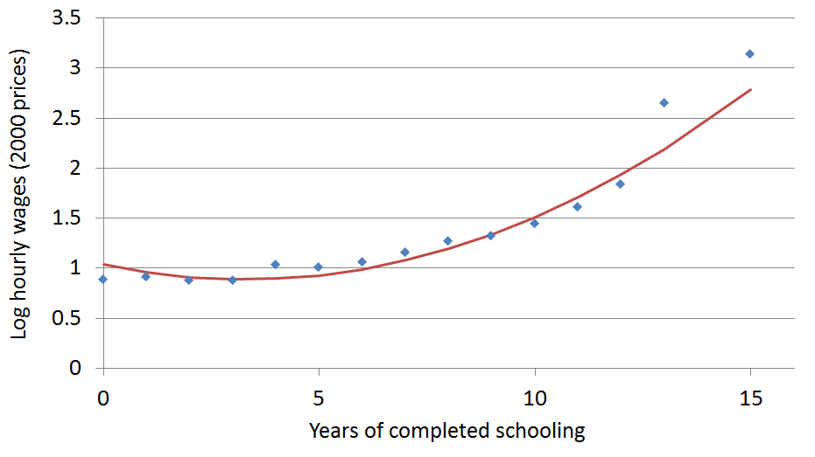
South African schooling-earnings profile

Slide 8
South African schooling-earnings profile
Usually interpret schooling-earnings profile as if it applies to all individuals:
  Low demand for all workers with less than tertiary education & high demand for all graduates.
  Reducing unemployment and wage inequality requires improving access to tertiary education (e.g. via subsidies or scholarships).
However, possible that different individuals have different profiles:
  Some individuals attend low quality schools where little learning takes place and tend to leave school early
  Other individuals attend high quality schools where much learning takes place and tend to leave school later

Slide 9
Schooling-earnings profile
Very high
Above average
Below average
Log hourly wages
Very low
Grade 10
Grade 12
Diploma
Degree
Years of completed schooling

Slide 10
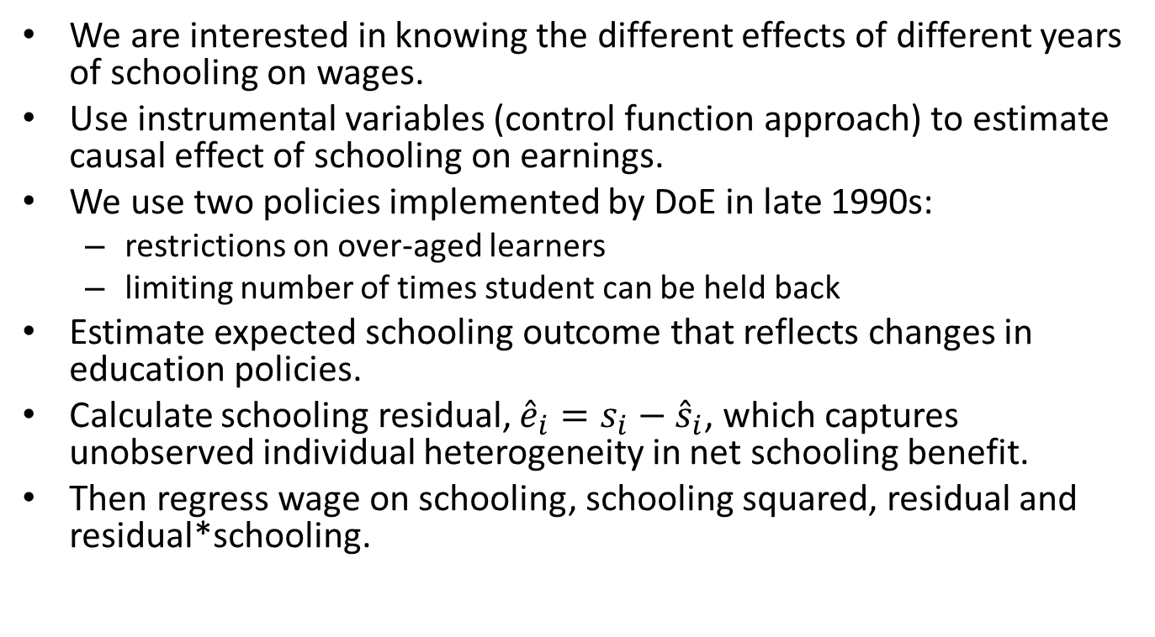
Identification strategy
We are interested in knowing the different effects of different years of schooling on wages.
Use instrumental variables (control function approach) to estimate causal effect of schooling on earnings.
We use two policies implemented by DoE in late 1990s:
  restrictions on over-aged learners
  limiting number of times student can be held back
Estimate expected schooling outcome that reflects changes in education policies.
Calculate schooling residual, ${\hat{e}}_{i}=s_{i}−{\hat{s}}_{i}$, which captures unobserved individual heterogeneity in net schooling benefit.
Then regress wage on schooling, schooling squared, residual and residual*schooling.

Slide 11
Wage regression estimates (black males aged 15-30, 1995-2005)
 | (1) | (2)
VARIABLES | lwage1 | lwage1
Years of schooling | -0.0641*** | 0.257***
 | (0.00736) | (0.0579)
Years of schooling^2 | 0.0126*** | -0.00516
 | (0.000416) | (0.00335)
Years of potential experience | 0.0194*** | 0.0226***
 | (0.00536) | (0.00606)
Years of potential experience^2 | -0.000294 | -0.000515**
 | (0.000246) | (0.000254)
Birth year | -0.0432*** | -0.0423***
 | (0.00166) | (0.00212)
Schooling residual |  | -0.159***
 |  | (0.0289)
Schooling residual* Years of schooling |  | 0.0182***
 |  | (0.00341)
Constant | 86.03*** | 82.78***
 | (3.305) | (4.229)
Observations | 33,954 | 33,954
R-squared | 0.226 | 0.227
Standard errors in parentheses
*** p<0.01, ** p<0.05, * p<0.1

Slide 12
Conclusion
When earnings profile is viewed as homogenous, then OLS estimates produce estimates that are artificially convex
High return individuals have steeper earnings profiles and choose to stay in education system for longer
Increasing access to schooling (without also improving school quality) will yield disappointing results
Improved schooling quality will produce two-fold benefit on labour market outcome:
  Increases wage benefit to each year of schooling
  Increases probability that individual will proceed to higher levels of schooling

Slide 13
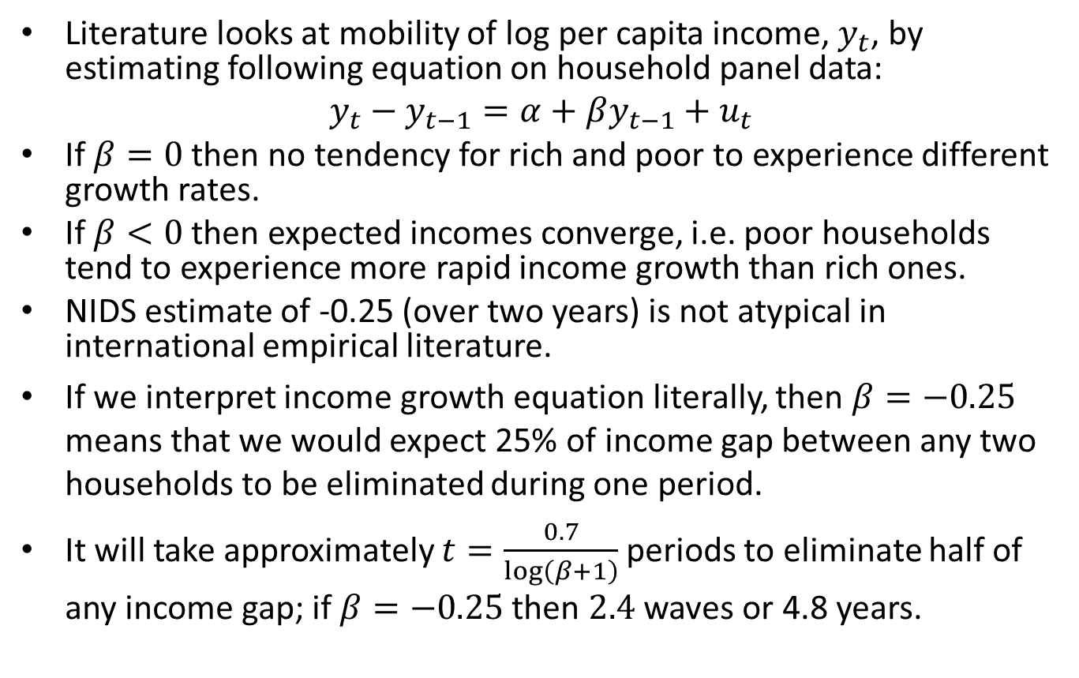
Income convergence & measurement error
Literature looks at mobility of log per capita income, $y_{t}$, by estimating following equation on household panel data:
$$y_{t}−y_{t−1}=α+βy_{t−1}+u_{t}$$
If $β=0$ then no tendency for rich and poor to experience different growth rates.
If $β<0$ then expected incomes converge, i.e. poor households tend to experience more rapid income growth than rich ones.
NIDS estimate of -0.25 (over two years) is not atypical in international empirical literature.
If we interpret income growth equation literally, then $β=−0.25$ means that we would expect 25% of income gap between any two households to be eliminated during one period.
It will take approximately $t=\frac{0.7}{\log\left(β+1\right)}$ periods to eliminate half of any income gap; if $β=−0.25$ then $2.4$ waves or 4.8 years.

Slide 14
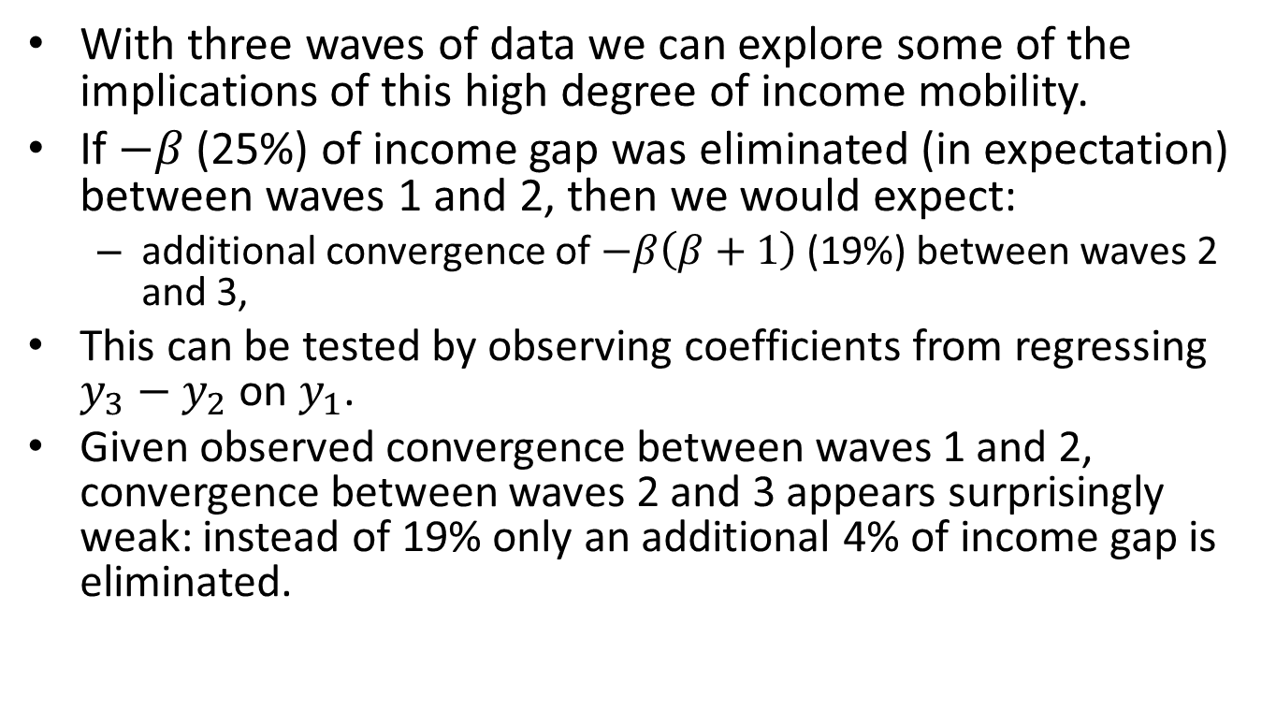
Implications of estimates
With three waves of data we can explore some of the implications of this high degree of income mobility.
If $−β$ (25%) of income gap was eliminated (in expectation) between waves 1 and 2, then we would expect:
  additional convergence of $−β\left(β+1\right)$ (19%) between waves 2 and 3,
This can be tested by observing coefficients from regressing $y_{3}−y_{2}$ on $y_{1}$.
Given observed convergence between waves 1 and 2, convergence between waves 2 and 3 appears surprisingly weak: instead of 19% only an additional 4% of income gap is eliminated.

Slide 15
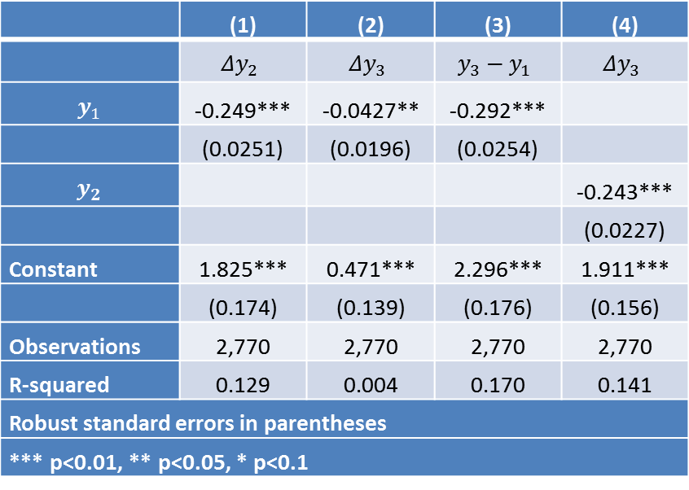

Estimates of $β$
 | (1) | (2) | (3) | (4)
 | $$Δy_{2}$$ | $$Δy_{3}$$ | $$y_{3}−y_{1}$$ | $$Δy_{3}$$
$$y_{1}$$ | -0.249*** | -0.0427** | -0.292***
 | (0.0251) | (0.0196) | (0.0254)
$$y_{2}$$ |  |  |  | -0.243***
 |  |  |  | (0.0227)
Constant | 1.825*** | 0.471*** | 2.296*** | 1.911***
 | (0.174) | (0.139) | (0.176) | (0.156)
Observations | 2,770 | 2,770 | 2,770 | 2,770
R-squared | 0.129 | 0.004 | 0.170 | 0.141
Robust standard errors in parentheses
*** p<0.01, ** p<0.05, * p<0.1

Slide 16
Measurement error
Many studies have expressed concern over effect of measurement error on income mobility
Suppose households sometimes report the wrong income, but that such errors are not persistent and have zero mean.
Households who accidentally over-reported incomes in the previous period will appear to experience slower income growth than households who under-reported their incomes.
Classical measurement error will therefore create the appearance of income mobility, even where none exists.
However, in a three-wave panel with measurement error, households that experienced rapid income growth between waves 1 and 2 should experience much slower income growth in subsequent period.

Slide 17
Income convergence & measurement error
Research question: How much income mobility is there really in SA?
We find that the convergence coefficient is
-0.06 (not -0.25) and that about 20% of the variation in income is due to measurement error.
This means that the expected half-life of any income gap is 27 years, not 5: South Africa has considerably less economic mobility than previous estimates would lead us to believe.
System GMM estimator J-test cannot reject over-identifying restrictions.
Extend to nonparametric estimator in which income mobility and reliability of income measure both depend on initial income level
Results:
  Income variable less reliable for lower income households.
  Income convergence relatively high for low-income groups; very low for high income households.

Slide 18

Estimates of $α$ and $β$

Slide 19
THANK YOU

Slide 20
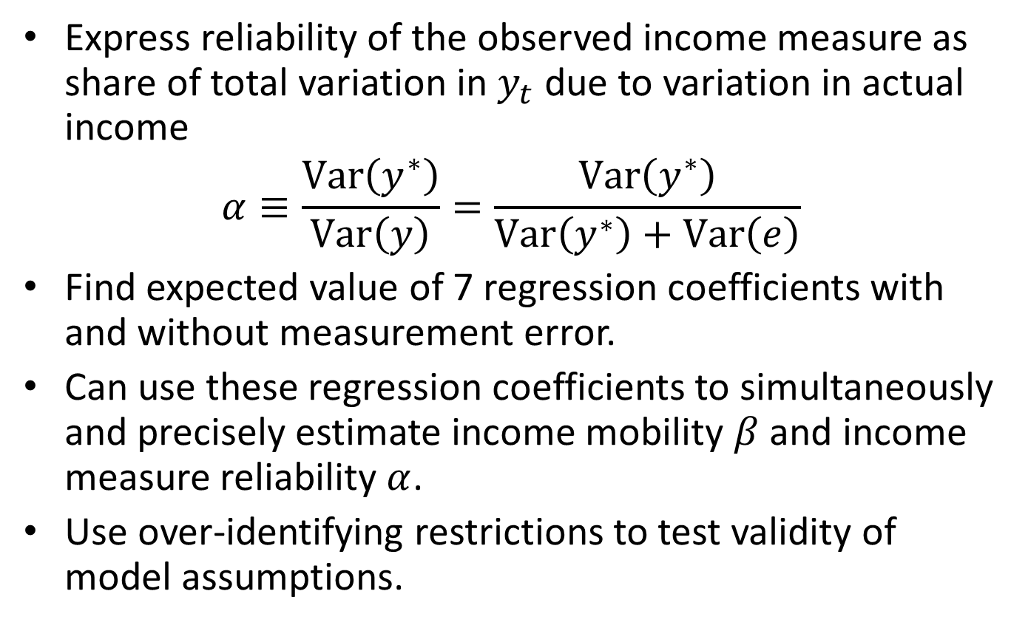
Model assumptions
Express reliability of the observed income measure as share of total variation in $y_{t}$ due to variation in actual income
$$α≡\frac{Var\left(y^{∗}\right)}{Var\left(y\right)}=\frac{Var\left(y^{∗}\right)}{Var\left(y^{∗}\right)+Var\left(e\right)}$$
Find expected value of 7 regression coefficients with and without measurement error.
Can use these regression coefficients to simultaneously and precisely estimate income mobility $β$ and income measure reliability $α$.
Use over-identifying restrictions to test validity of model assumptions.

Slide 21
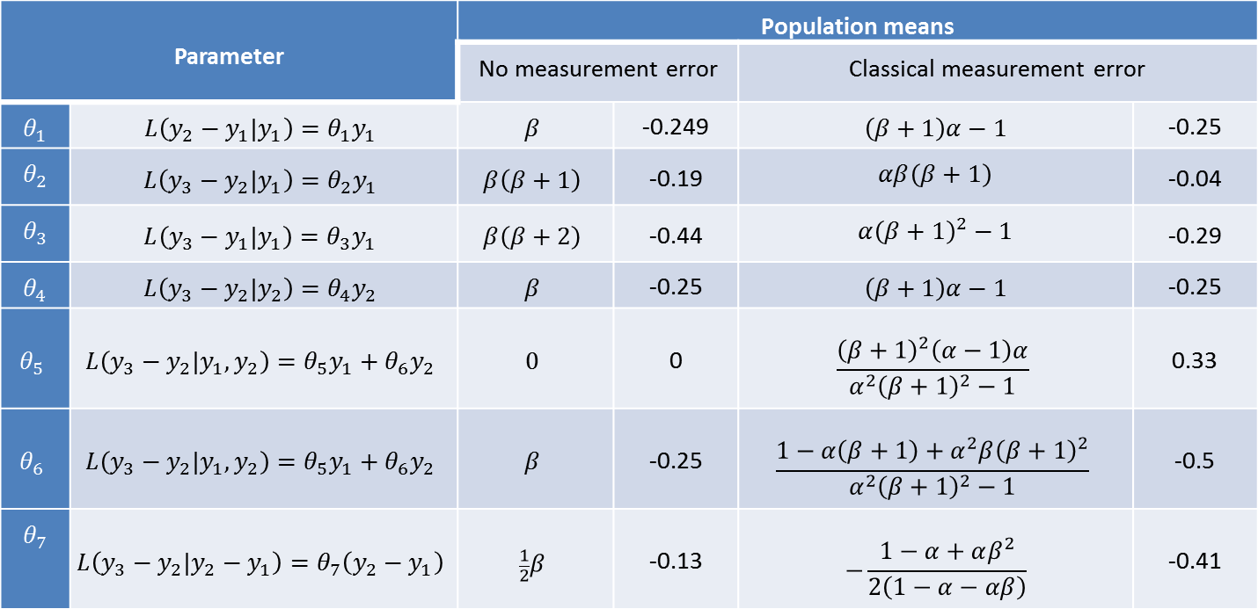
7 Regression coefficients
Parameter |  | Population means
 |  | No measurement error |  | Classical measurement error
$$θ_{1}$$ | $$L\left(y_{2}−y_{1}|y_{1}\right)=θ_{1}y_{1}$$ | $$β$$ | -0.249 | $$\left(β+1\right)α−1$$ | -0.25
$$θ_{2}$$ | $$L\left(y_{3}−y_{2}|y_{1}\right)=θ_{2}y_{1}$$ | $$β\left(β+1\right)$$ | -0.19 | $$αβ\left(β+1\right)$$ | -0.04
$$θ_{3}$$ | $$L\left(y_{3}−y_{1}|y_{1}\right)=θ_{3}y_{1}$$ | $$β\left(β+2\right)$$ | -0.44 | $${α\left(β+1\right)}^{2}−1$$ | -0.29
$$θ_{4}$$ | $$L\left(y_{3}−y_{2}|y_{2}\right)=θ_{4}y_{2}$$ | $$β$$ | -0.25 | $$\left(β+1\right)α−1$$ | -0.25
$$θ_{5}$$ | $$L\left(y_{3}−y_{2}|y_{1},y_{2}\right)=θ_{5}y_{1}+θ_{6}y_{2}$$ | $$0$$ | 0 | $$\frac{{\left(β+1\right)}^{2}\left(α−1\right)α}{α^{2}{\left(β+1\right)}^{2}−1}$$ | 0.33
$$θ_{6}$$ | $$L\left(y_{3}−y_{2}|y_{1},y_{2}\right)=θ_{5}y_{1}+θ_{6}y_{2}$$ | $$β$$ | -0.25 | $$\frac{1−α\left(β+1\right)+α^{2}{β\left(β+1\right)}^{2}}{α^{2}{\left(β+1\right)}^{2}−1}$$ | -0.5
$$θ_{7}$$ | $$L\left(y_{3}−y_{2}|y_{2}−y_{1}\right)=θ_{7}\left(y_{2}−y_{1}\right)$$ | $$\frac{1}{2}β$$ | -0.13 | $$−\frac{1−α+αβ^{2}}{2\left(1−α−αβ\right)}$$ | -0.41

