Slide 1
David McCarthy
NIESR, London, UK
Centre for Macroeconomics www.agenta-project.eu
National Transfer Accounts

Slide 2
Outline
National Transfer Accounts (+ extensions)
Thorny questions
  Longitudinal vs cross-sectional
  The question of incidence

Slide 3
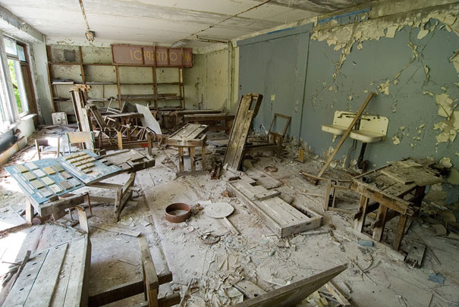
The difficulties of storage
(On a generational timescale, storage is very difficult)
Picture shows Pripyat, nr Chernobyl, Ukraine

Slide 4
The circular flow
So what the old and the young consume, others must produce

Slide 5
Ways of saving for retirement
Storing up consumption goods in advance | Stores of value | Income-producing capital, or shares in it | Having babies
Owner-occupied real-estate. Durable goods (e.g. cars, domestic appliances). Infrastructure. | Gold coins. Bank notes. Jewellery. Antiques. Fine art. Other collectibles. | Non-owner-occupied real estate. Businesses. Land & improvements. Bank deposits. Shares. Other financial assets. | Intra-household transfers, (e.g. multi-generational households). Inter-household transfers (e.g. remittances). Public transfers (e.g. PAYG pension systems, public medical care).
And there are only four ways of saving for retirement
(Different societies use different mix of the four)

Slide 6
National Transfer Accounts
Individual (not HH) based
Consumption (not income) based
Aims to quantify the relative importance of different institutions in shifting resources across the lifecycle in different societies:
  Private transfers (family or extended family support)
  Capital markets (stocks, shares, pension funds)
  Public transfers (state old age pensions, public health care, public education, infrastructure, law and order, etc)

Slide 7
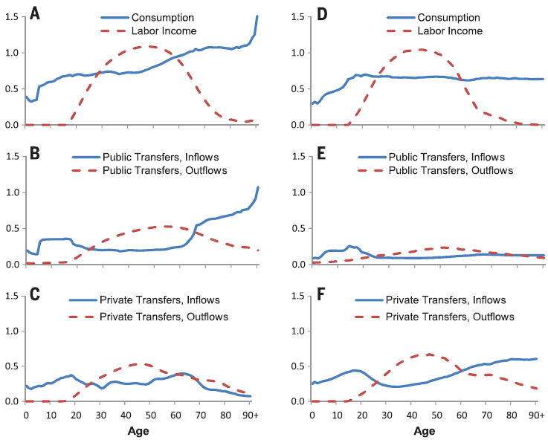
Results for US & Thailand
There are now ~40 countries participating in the project
Barro (transfers to elderly are saved and bequeathed) vs Feldstein (transfers to the elderly are spent)

Slide 8
Results for the UK (2007)

Slide 9
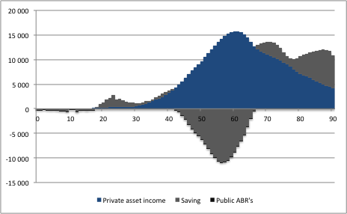
Disaggregation of ABR’s
Saving is a balancing item
  Shows some dissaving at older ages (not too surprising, given the reliance of the UK aged on funded pensions)

Slide 10
Wealth across the lifecycle
Quantifies the relative importance of transfer wealth across the world (e.g. Kotlikoff & Summers)
Classical LC-PIH
NTA (rich country, here UK)

Slide 11
Cross-sectional vs longitudinal
NTA profiles are cross-sectional
  One-year ‘snapshot’ of age-related transfers in a particular economy and the institutions that mediate them
  How to turn this into a longitudinal forward-looking picture of the lifetime of a particular cohort?
    Policy, factor price stability
    Discount rates
    Impact of changing demography

Slide 12
The thorny question of incidence
NTA makes the same assumptions about incidence as generational accounting
  Broadly, incidence is on those that pay the tax or receive the benefit
But this is highly problematic (Buiter, 1996)
  In effect, we are ignoring all changes in factor prices associated with public and private transfer systems, at least those that differ systematically across the life cycle

Slide 13
Distributional impact of transfers
NTA says nothing about distributional impacts of transfer mechanisms within a particular cohort
Challenge is that individuals move through the wealth distribution in systematic ways as they age
  v. hard to know how to move from cross-sectional analysis to longitudinal analysis in a way that does not simply reflect our assumptions
Holy grail is joint age and wealth-driven picture of transfers

Slide 14
Current UK NTA projects
AGENTA
  Historical NTA; integrating time-use surveys; DSGE & NTA
With colleagues from Imperial we are using NTA to investigate:
  Which generation bore the brunt of the financial crisis in 2007-2008
  The history of inter-generational transfers in the UK, by constructing past estimates of NTA’s
  The implications of these results for how shocks are transmitted through the economy
    Traditional models of asset pricing assume that ALL shocks are transmitted through financial markets, assumption is wrong and may lead to problems in getting models to fit data well

